Slide 1

Imposter Syndrome: I Don't Feel Like Who You Think I Am.
Micah Hoffman
https://webbreacher.com
©2017 Spotlight Infosec LLC

Slide 2




Who am I?
Pentester/OSINTer
Manager/Mentor
Instructor (Web Hacking)
NoVA Hacker
Open Source Contributor
Novahackers.com

Slide 3
I work through
Imposter Feelings
daily

Slide 4
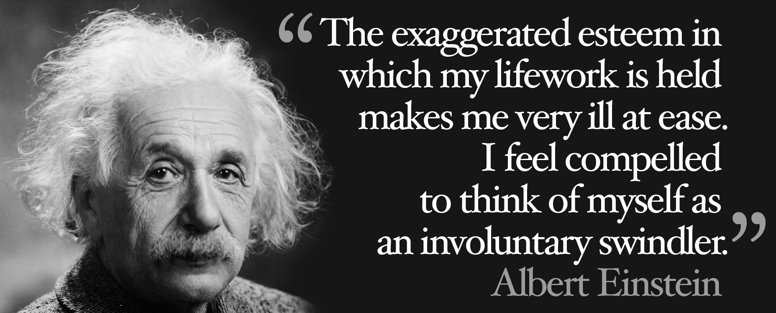
Notes:
https://www.depts.ttu.edu/vpr/scholarly-messenger/Images/einstein-quote.jpg, February 23, 2017.

Slide 5
Albert Einstein
Notes:
https://www.depts.ttu.edu/vpr/scholarly-messenger/Images/einstein-quote.jpg, February 23, 2017.

Slide 6
Albert Einstein
Created Theory of Relativity in 1905
Notes:
https://www.depts.ttu.edu/vpr/scholarly-messenger/Images/einstein-quote.jpg, February 23, 2017.

Slide 7
Albert Einstein
Created Theory of Relativity in 1905
E=MC²
Notes:
https://www.depts.ttu.edu/vpr/scholarly-messenger/Images/einstein-quote.jpg, February 23, 2017.

Slide 8
Albert Einstein
Created Theory of Relativity in 1905
E=MC²
Nobel Prize for Physics
Notes:
https://www.depts.ttu.edu/vpr/scholarly-messenger/Images/einstein-quote.jpg, February 23, 2017.

Slide 9
Albert Einstein
Created Theory of Relativity in 1905
E=MC²
Nobel Prize for Physics
Gravitational waves
Notes:
https://www.depts.ttu.edu/vpr/scholarly-messenger/Images/einstein-quote.jpg, February 23, 2017.

Slide 10
Albert Einstein
Created Theory of Relativity in 1905
E=MC²
Nobel Prize for Physics
Gravitational waves
Theory of critical opalescence
Notes:
https://www.depts.ttu.edu/vpr/scholarly-messenger/Images/einstein-quote.jpg, February 23, 2017.

Slide 11
Albert Einstein
Created Theory of Relativity in 1905
E=MC²
Nobel Prize for Physics
Gravitational waves
Theory of critical opalescence
Zero-point energy
Notes:
https://www.depts.ttu.edu/vpr/scholarly-messenger/Images/einstein-quote.jpg, February 23, 2017.

Slide 12
Albert Einstein
Created Theory of Relativity in 1905
E=MC²
Nobel Prize for Physics
Gravitational waves
Theory of critical opalescence
Zero-point energy
Modern quantum theory
Notes:
https://www.depts.ttu.edu/vpr/scholarly-messenger/Images/einstein-quote.jpg, February 23, 2017.

Slide 13
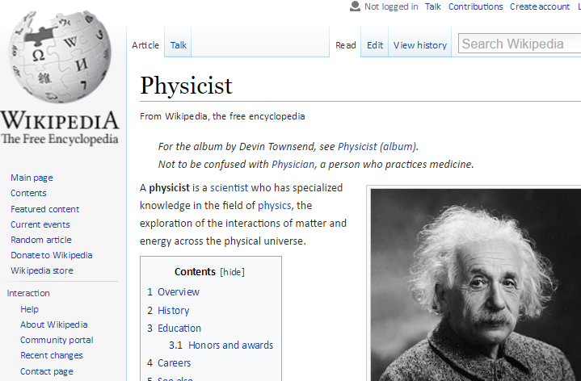
Notes:
https://en.wikipedia.org/wiki/Physicist, February 23, 2017.

Slide 14
Notes:
https://www.depts.ttu.edu/vpr/scholarly-messenger/Images/einstein-quote.jpg, February 23, 2017.

Slide 15
He felt
like a fraud

Slide 16
He could not
internalize
success

Slide 17
His subjective perception
overpowered
objective reality

Slide 18
This is
Imposter
Syndrome

Slide 19

DerbyCon Conference
Notes:
https://web.archive.org/web/20120426064212/http://www.derbycon.com/, February 23, 2017.

Slide 20
What was I
contributing to
the infosec field?

Slide 21
I was
just
testing web apps

Slide 22
I had no
0-day
exploits

Slide 23
I didn't know
how to program

Slide 24
From the outside, my life
was quite good

Slide 25
I
looked for work
outside infosec

Slide 26
Listening
to a podcast
I heard...

Slide 27
Imposter
Syndrome

Slide 28
Imposter Syndrome
Imposter Phenomenon
or
Imposter Feelings
Notes:
"Many people identify themselves as sufferers, but it's a matter of debate as to whether IP is actually a distinct emotional or psychological condition. "A whole lot more has been made of this for commercial purposes than it deserves," says Mayada Akil, medical director of the outpatient programme in the psychiatry department at Georgetown University Hospital in Washington DC. In recent years, it has drawn significant interest as the subject of books, talk shows and popular-magazine articles. "I think the emotional experience exists, but it is not a disorder or syndrome," says Akil. Rather, she suggests, other underlying maladies such as depression are responsible for severely impeding work. Depression is a true disorder, she says."
From <http://www.nature.com/naturejobs/science/articles/10.1038/nj7245-468a>

Slide 29
First described by
Dr. Suzanne Imes &
Dr. Pauline Rose Clance
in a 1978 paper

Slide 30
Your subjective perception
overpowers
objective reality

Slide 31
You see yourself
differently
than others do

Slide 32
Can manifest as
psychological disorders and real-world issues
Depression
Anxiety
Low self-confidence
Avoidance
Work problems

Slide 33
Imposter Feelings
may come and go
within a person

Slide 34
About 70% of people experience
at least one episode
in their life
Notes:
Gravois, J. (2007). You're not fooling anyone. The Chronicle of Higher Education, 54(11), A1. Retrieved November 5, 2008, from http:// chronicle. com

Slide 35
Impacts all races,
genders, ages,
and professions
Notes:
http://bsris.swu.ac.th/journal/i6/6-6_Jaruwan_73-92.pdf

Slide 36
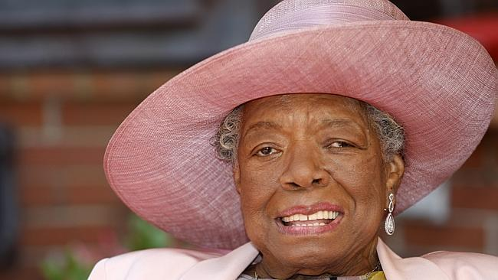
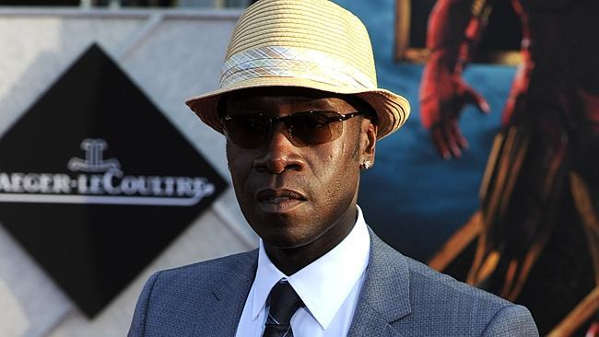



Maya Angelou
Jennifer Lopez
Don Cheadle
Tina Fey
Daniel Radcliffe
Notes:
http://www.marieclaire.co.uk/entertainment/celebrity-quotes-on-impostor-syndrome-434739, http://www.imdb.com/name/nm0000158/, April 5, 2017.
http://www.npr.org/2016/04/26/475573489/tom-hanks-says-self-doubt-is-a-high-wire-act-that-we-all-walk
http://www.news.com.au/finance/highachievers-suffering-from-imposter-syndrome/news-story/9e2708a0d0b7590994be28bb6f47b9bc

Slide 37
Pressure to
achieve

Slide 38
People surrounded
by high-achievers

Slide 39
Starting
new projects or
new work

Slide 40
The longer
you are in a field
the higher
likelihood of IP

Slide 41
Dunning-Kruger Effect
"cognitive bias of illusory superiority"
Notes:
https://en.wikipedia.org/wiki/Dunning%E2%80%93Kruger_effect

Slide 42
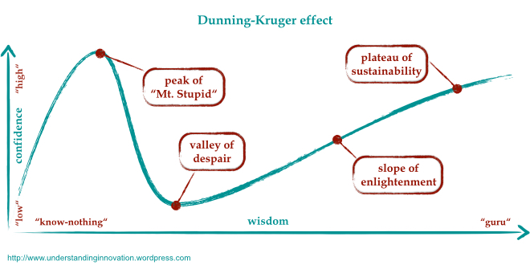
Notes:
https://wisdomofhands.blogspot.com/2015/12/the-peak-of-mount-stupid.html, February 25, 2017.

Slide 43

Imposter Feelings
Notes:
https://wisdomofhands.blogspot.com/2015/12/the-peak-of-mount-stupid.html, February 25, 2017.

Slide 44
Imposter Feelings
Reality
What I
know
What
others
know

Slide 45
The
Imposter Feelings Cycle
Notes:
Clance, P. R. (1985). The Impostor Phenomenon: Overcoming the fear that haunts your success. Atlanta, GA: Peachtree.

Slide 46
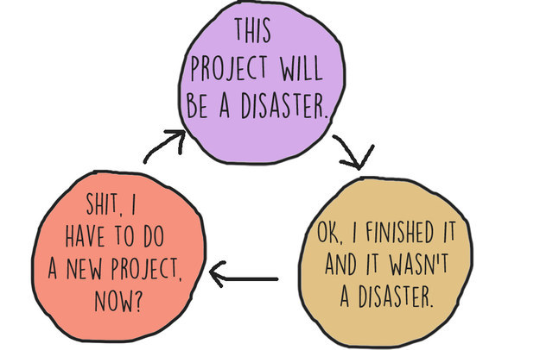
Kristin Chirico/BuzzFeed
https://www.buzzfeed.com/kristinchirico/13-charts-that-will-make-total-sense-to-people-with-impostor

Slide 47
Achievement-related Tasks
Anxiety, Self-doubt, Worry
Over-preparation
Procrastination
Perceived Fraudulence
Increased self-doubt
Depression
Anxiety
Accomplishment
Feeling of relief
Positive feedback
Effort
Luck
Discount positive feedback
Notes:
"The Imposter Phenomenon"
Jaruwan Sakulku and James Alexander
2011 International Journal of Behavioral Sciences
derived from Clance, P. R. (1985). The Impostor Phenomenon: Overcoming the fear that haunts your success. Atlanta, GA: Peachtree.

Slide 48
Fear of success
and
Fear of failure

Slide 49
Negative
self-talk

Slide 50
Failure to try
and
Failure to apply

Slide 51
Failure to try
where there is
public scrutiny

Slide 52


Slide 53


Slide 54


Slide 55





Slide 56
Do I have
Imposter
Feelings?

Slide 57
Do you feel like a fraud?
Are you unable to internalize success?

Slide 58
A continuum of
signs and feelings
Few
Moderate
Frequent
Intense
http://paulineroseclance.com/pdf/IPscoringtest.pdf

Slide 59
There are
online tests
https://goo.gl/aNzrVc

Slide 60
#YouAreNotAlone

Slide 61
People with
Imposter Feelings
suffer in silence

Slide 62
Work to overcome
Imposter Feelings

Slide 63
Recognize
trigger feelings
and situations

Slide 64
Identify
your feelings

Slide 65
Talk about it:
to yourself
to a mentor/friend
to a professional

Slide 66
Stop looking
at the experts
and look at where
you have been

Slide 67
Track your
achievements,
accomplishments
and progress

Slide 68
OWN your
achievements,
accomplishments
and progress

Slide 69
Avoid using
minimizing language
pretty sure
kind of
just
only

Slide 70
Practice
accepting
compliments
http://www.growhealthylife.com/8-ways-to-combat-imposter-syndrome/

Slide 71
You a perfectionist?
Work until it is
good enough

Slide 72
Put a
time limit
on revising work
http://www.growhealthylife.com/8-ways-to-combat-imposter-syndrome/

Slide 73
This
will
take time

Slide 74

Nickolas Means, "You are Not an Impostor"
2014 RailsConf YouTube Video https://goo.gl/c27q73

Slide 75
high-functioning imposter

Slide 76

Imposter Feelings Resources
https://goo.gl/c8txwQ
Micah Hoffman
@WebBreacher
https://webbreacher.com

